Slide 1
The Early Steps Program
Early Steps Program

Slide 2
Regulatory Authority
Federal Register, 34 CFR Part 303
  Under the federal Individuals with Disabilities Education Act (IDEA), Part C, the Florida Department of Health is established as the lead agency.
  Florida Interagency Coordinating Council for Infants and Toddlers (FICCIT).
Chapter 391.301–.308, Florida Statutes.

Slide 3
Program Goals
Build family and caregiver confidence and competence.
Provide services that support children where they live, learn, and play.
Expand upon the individual strengths of the family to address developmental concerns.

Slide 4
Core Principles
Each child is unique.
Every family’s needs are different.
Early intervention works best when the family is supported in meeting their child’s needs.
The parent, family, or caregiver is the child’s best teacher.
The family’s concerns, priorities, and culture are valued.
Children learn best in settings that include all children.

Slide 5
State Structure
Contracts with 15 local programs
Provide or oversee direct services to infants, toddlers, and their families.
Variety of organizational structures:
  Hospitals
  Universities
  Non-profit organizations

Slide 6
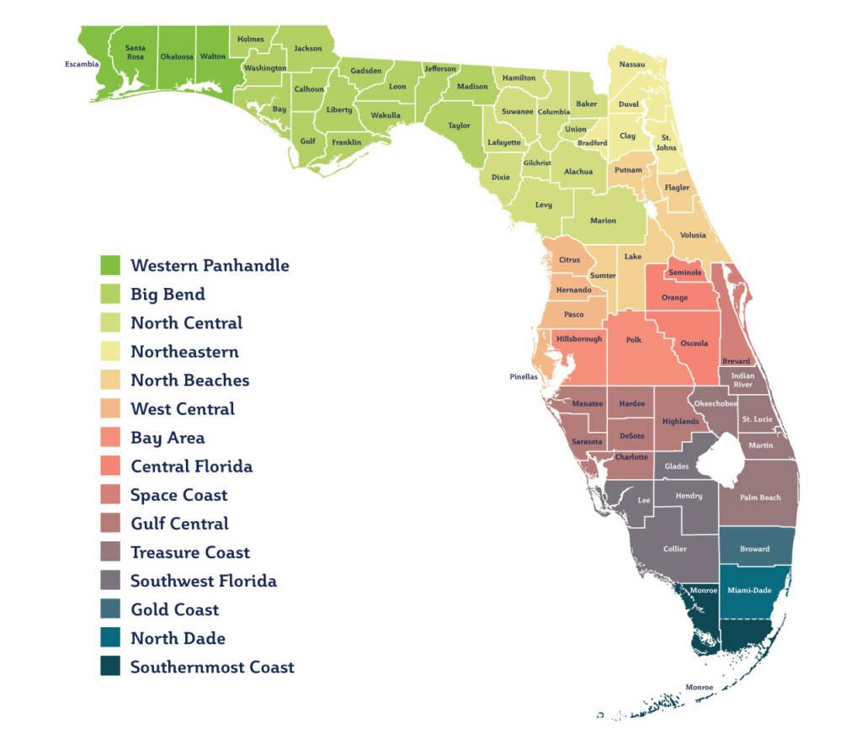
Local Early Steps Regions

Slide 7
Eligibility
Birth to three years old.
Developmental delay.
Established conditions that commonly cause developmental delays.
At-risk conditions.
No income requirement.

Slide 8
Referral Sources
Pediatricians and Specialists
Childcare Providers
Families
Hospitals
Department of Children and Families
Child Protection Teams
Early Learning Coalition
Community Agencies and Providers
Others

Slide 9
Initial Contact with Family
Contact with the family is made within five days.
Additional information is gathered and shared during the first contact, such as:
  A family assessment is completed to determine family concerns, priorities, and resources.
  The child's diagnosis is documented, if applicable.
  A developmental screening, evaluation and/or assessment is completed.

Slide 10
Individualized Family Support Plan (IFSP)
The service coordinator must convene the IFSP team members in a face-to-face meeting to develop the initial IFSP for each eligible child and family.
The IFSP process is family-centered and documents the following:
  Family’s concerns, priorities, and resources​
  Evaluation and/or assessment results​
  Expected outcomes​
  Strategies to achieve outcomes, including supports, services, and community resources

Slide 11
Early Intervention Services
Assistive technology
Early intervention sessions
Counseling
Therapies
Vision and hearing services
Other required services

Slide 12
Early Steps Providers
Early intervention services must be provided by qualified personnel:
  Speech Language Pathologists
  Audiologists
  Occupational Therapists
  Physical Therapists
  Infant Toddler Development Specialists
  Psychologists
  Social Workers
  Nurses
  Registered Dietitians
  Nutrition Counselors
  Family Therapists

Slide 13
Service Delivery
Team-based primary service provider approach.
Aims to enhance family and caregiver competence, confidence, and capacity to meet their child’s developmental needs and desired outcomes.
Evidence-based practices are utilized.
Services can be delivered in a variety of ways:
  Direct service provision, which includes coaching
  Co-visits
  Consultations

Slide 14

Jessica O. Meyer, MSW
850-841-8647
Jessica.Meyer@FLHealth.gov
Dusty Stern, RN, BSN
850-841-8652
Dusty.Stern@FLHealth.gov
Early Steps
Bureau of Early Steps and Newborn Screening
Division of Children’s Medical Services
Florida Department of Health

